Slide 1
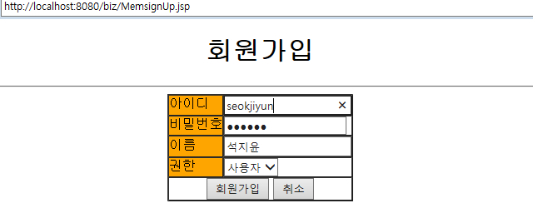
주요 소스 [Code Review]
MemsignUp.jsp
jsp, html, css
<%@ page contentType="text/html; charset=UTF-8" %>
<html>
<head>
<meta http-equiv="Content-Type" content="text/html; charset=UTF-8">
<title>회원가입</title>
</head>
<body>
<center>
<h1>회원가입</h1>
<hr>
<form action="joinUser_proc.jsp" method="post">
<table border="1" cellpadding="0" cellspacing="0">
<tr>
<td bgcolor="orange">아이디</td>
<td><input type="text" name="id"/></td>
</tr>
<tr>
<td bgcolor="orange">비밀번호</td>
<td><input type="password" name="password"/></td>
</tr>
<tr>
<td bgcolor="orange">이름</td>
<td><input type="text" name="name"/></td>
</tr>
<tr>
<td colspan="2" align="center">
<input type="submit" value="가입하기"/>
</td>
</tr>
</table>
</form>
<hr>
</center>
</body>
</html>
Here : Result Image Insert
회원가입정보들을 DAO class 통해 DB연동해 데이터 전함. 처리한 다음에 회원가입

